Slide 1


Classification of Hypertension on Individuals using Decision Tree Algorithm
DURAN DUMAN 190101037

Slide 2
What i aimed for this project
For this project, my primary goal was to develop a decision tree classifier capable of identifying the presence of hypertension in individuals based on 6 features.
To gather comprehensive data, I used Google Forms to collect a total of 135 answers.

Slide 3
Features, used for classification
Features (X)
Age : ( [0-30] , [31-50] , [51-70] )
Gender : (Male, Female)
Family History of Hypertension : (There is, There isn’t)
Physical Activity : (Low, Medium, High)
Smoking Status : (I smoke, I don’t smoke)
Alchocol Consumption : (I drink, I don’t drink)
Target Variable (y)
Hypertension : (I have, I haven’t)

Slide 4

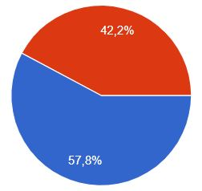
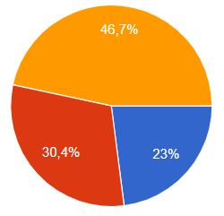
Feature - Gender
Feature - Age
Male
0-30
31-50
Female
51-70

Slide 5
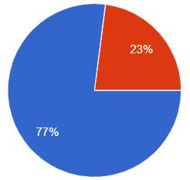
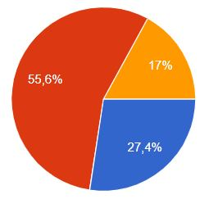
Feature – Family History
Feature – Physical Activity
There is
Low
Medium
There isn’t
High

Slide 6
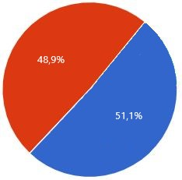
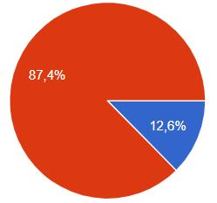
Feature - Smoke
Feature – Alchocol
I smoke
I drink
I don’t smoke
I don’t drink

Slide 7
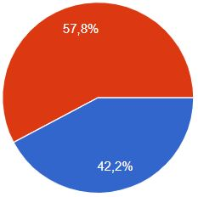
Target Variable - Hypertension
I have
I don’t have

Slide 8
Calculations on the dataset
To get accuracy results using my train dataset, I used 5 Fold Cross Validation to create the test sets.
For each fold, I calculated the Confusion Matrixes. And got the average confusion matrix using each fold’s confusion matrix.
And after that I calculated the overall accuracy using the average confusion matrix.
Moreover, I calculated the f1 score for each fold and got the overall f1 score for 5 folds.

Slide 9
The Results for fold 1 , 2 , 3
Fold 1
Confusion Matrix:
[[6 6]
[7 8]]
X_train length : 108
X_test length : 27
F1 Score : 0.5517
Accuracy : 0.5185
Fold 2
Confusion Matrix:
[[8 4]
[7 8]]
X_train length : 108
X_test length : 27
F1 Score : 0.5926
Accuracy : 0.5926
Fold 3
Confusion Matrix:
[[9 2]
[7 9]]
X_train length : 108
X_test length : 27
F1 Score : 0.6667
Accuracy : 0.6667
[[(TN) ,(FP)]
[(FN), (TP)]]
[[(TN) ,(FP)]
[(FN), (TP)]]
[[(TN) ,(FP)]
[(FN), (TP)]]

Slide 10
The Results for fold 4, 5
Fold 4
Confusion Matrix:
[[6 5]
[7 9]]
X_train length : 108
X_test length : 27
F1 Score : 0.6000
Accuracy : 0.5556
Fold 5
Confusion Matrix:
[[6 5]
[7 9]]
X_train length : 108
X_test length : 27
F1 Score : 0.6000
Accuracy : 0.5556
[[(TN) ,(FP)]
[(FN), (TP)]]
[[(TN) ,(FP)]
[(FN), (TP)]]

Slide 11
Overall Results
Overall Accuracy
0.5778
57.78%
Average Confusion Matrix
[[7. 4.4]
[7. 8.6]]
Overall F1 Score
0.6022
60.22%

